Slide 1
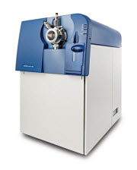
BET protein bromodomain-dependent interactome
3XFLAG BRD2, BRD3, BRD4S, BRD4L or BRDT
5 x 15cm plates HEK293
0.5uM JQ1 treatment 5hours
Anti-FLAG IP
Trypsin digestion
TripleTOF 5600
IDA analysis
SWATH-MS

Slide 2
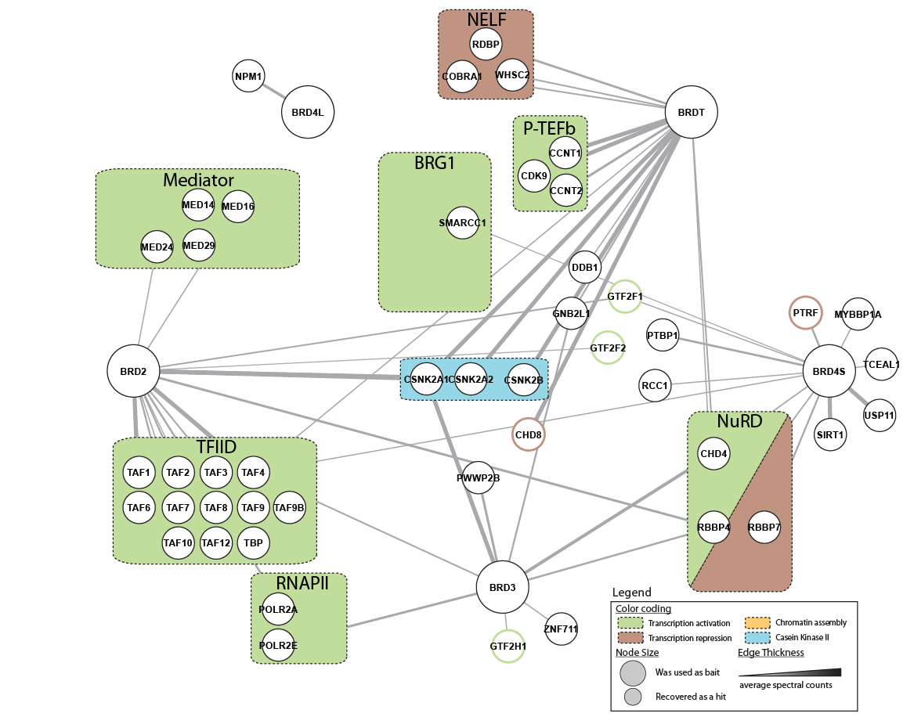
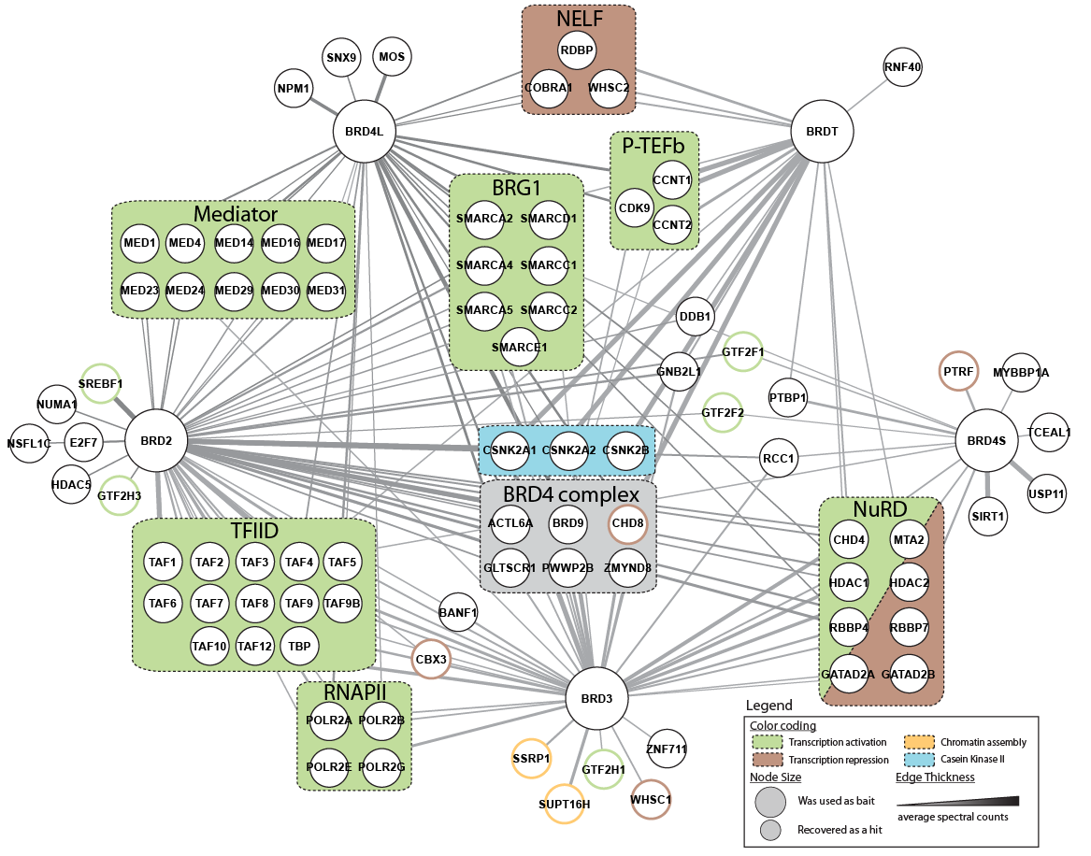
BET protein bromodomain-dependent interactome
+ 500nM JQ1
BET BD inhibitor
IDA analysis

Slide 3
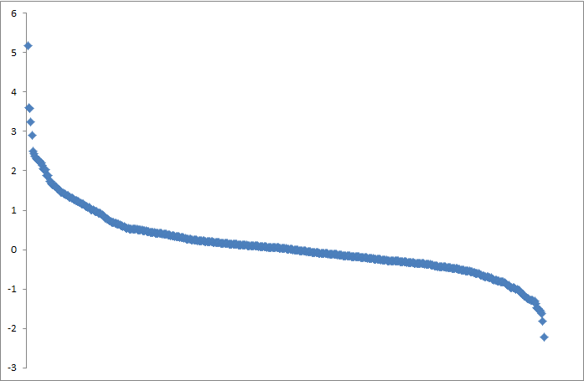
Observed modulation of copurified proteins following JQ1 treatment of 3XFLAG-Brd3 by SWATH
TCOF1
KBTBD8
POLR1C
MRN complex (Mre11, Rad50, NBN)
Log2 (plusJQ1/minusJQ1)
Histones (6)
FACT complex (2)
~500 proteins quantified

